Slide 1

Supportlytics
Optimizing IT Support Team Performance Using Analytics
Milestone 2 — Week 3–4
Presented by Srikanth K

Slide 2
Milestone 2 Overview
Module 3 — Exploratory Visualization
Module 4 — Similarity & Cluster Analysis
Deliverables
Concrete outputs produced in Milestone 2.
Understand ticket distribution and identify operational patterns using visual analytics.
Group similar tickets and interpret clusters for operational decisions.
Exploratory Data Analysis
Cluster-based grouping & queue mapping
Similarity analysis and business insights
Similarity Score Analysis
Cluster Formation & Distribution
Queue vs Priority by cluster
Business interpretation
Ticket Type Distribution
Top Categories by Frequency
Ticket Volume by Priority & Queue
Comparative distribution analysis

Slide 3
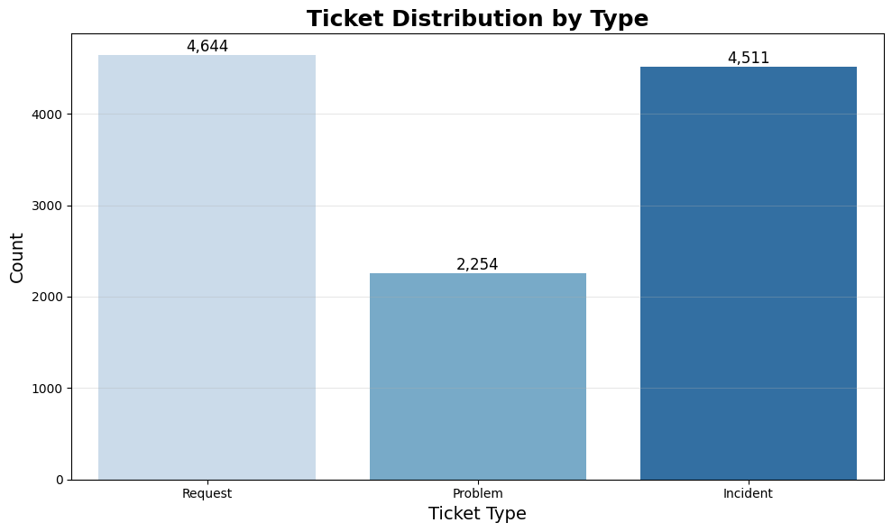
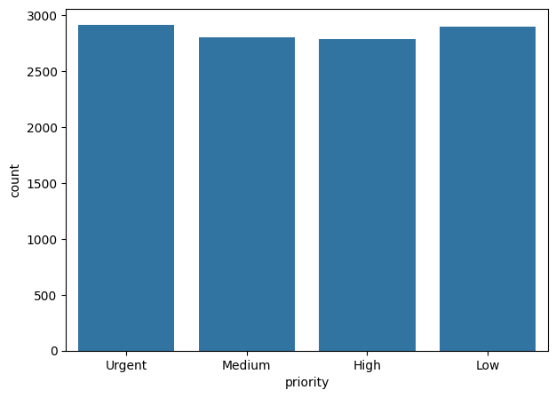
Ticket Volume by Priority and Type
Ticket Distribution by Type
Request tickets represent the largest share of the overall support workload.
Incident tickets occur frequently and require timely resolution.
Problem tickets are fewer, as they focus on identifying root causes of recurring issues.
Understanding ticket types helps improve support planning and operational decision-making.
Ticket Volume by Priority
Ticket volume is distributed almost evenly across all priority levels.
Urgent and High priority tickets require faster response and resolution.
The balanced distribution indicates a consistent workload across priorities.
Priority analysis helps optimize resource allocation and service efficiency.

Slide 4
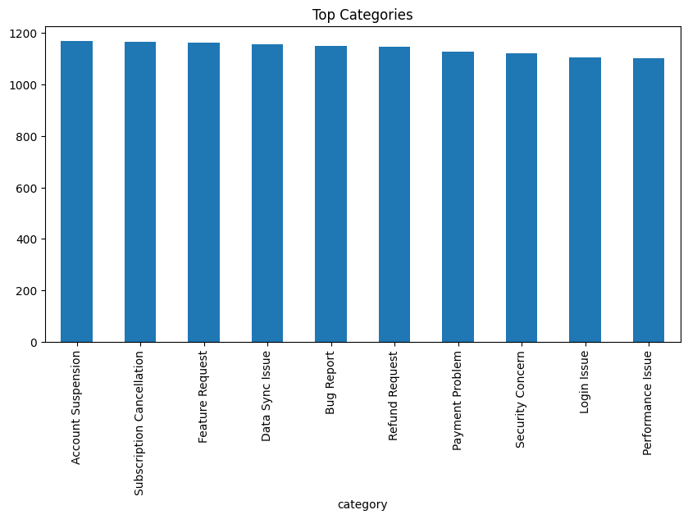
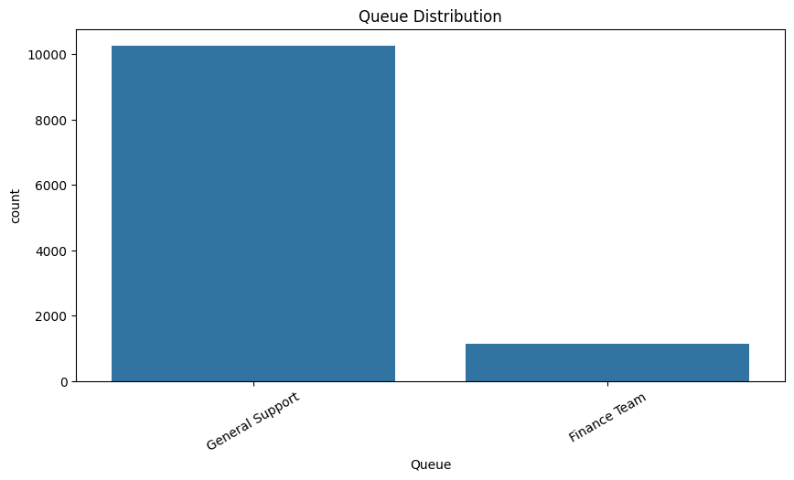
Ticket Volume by Category and Queue
Top Categories
Ticket volume is distributed across multiple support categories.
Account Suspension and Subscription Cancellation show slightly higher ticket counts.
No single category dominates, indicating a diverse range of customer issues.
Category analysis helps identify recurring problems and improve support services.
Queue Distribution
General Support handles the majority of support tickets.
Finance Team receives a comparatively smaller number of tickets.
Queue distribution highlights workload differences across support teams.
These insights help optimize resource allocation and improve operational efficiency.

Slide 5
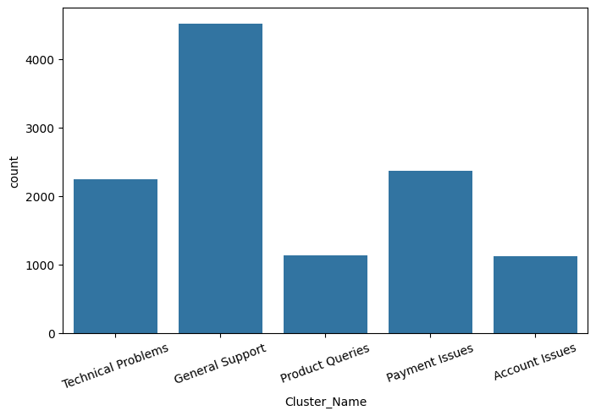
Ticket Volume by Cluster Name
Business-oriented clustering groups tickets into operationally meaningful clusters:
Technical Problems
General Support
Payment Issues
Product Queries
Account Issues

Slide 6
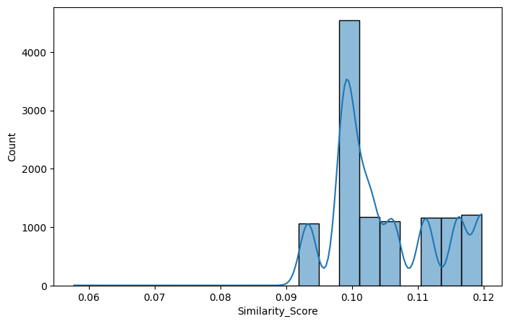

Similarity Score Analysis
Similarity scores quantify textual similarity between tickets; higher values indicate more closely related descriptions.
Key Observation
Scores concentrate within a narrow band, showing consistent language in tickets.
High-similarity groups are candidates for automated routing and templated responses.
Stable patterns support supervised learning for future automation.

Slide 7
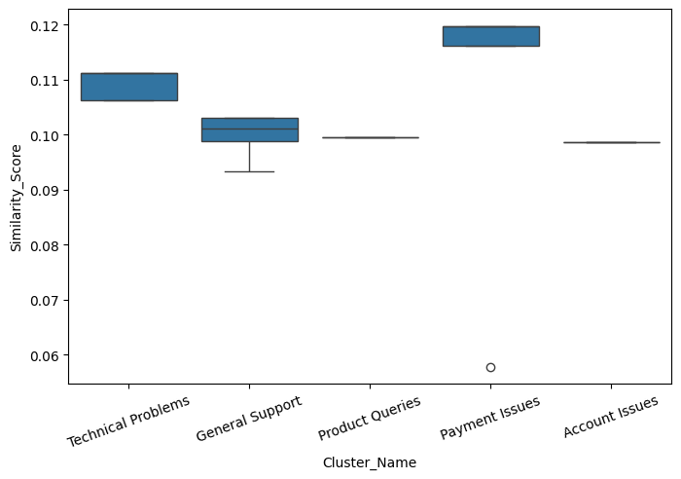
Cluster Name vs Similarity Score
Cluster Name vs Similarity Score
Similarity scores indicate how closely tickets within each cluster are related.
Payment Issues cluster shows the highest similarity, indicating highly consistent ticket patterns.
General Support and Technical Problems have moderate similarity due to a wider variety of issues.
The clustering approach helps group related tickets, enabling faster ticket routing and improved support efficiency.

Slide 8
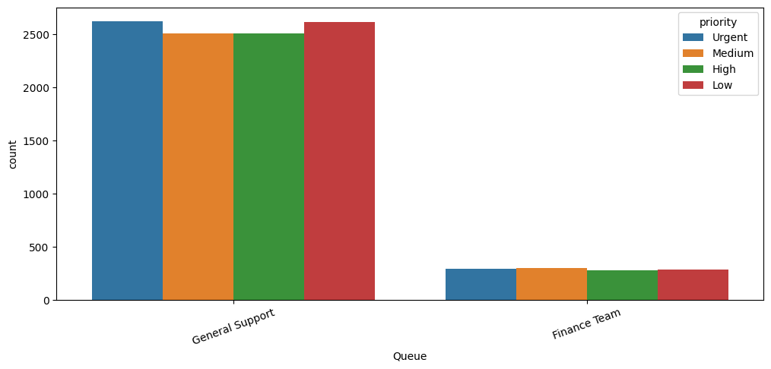
Queue with Priority Analysis
.
The queue distribution is compared across different priority levels to understand workload allocation.
Most tickets are handled by the General Support queue across all priority levels.
The Finance Team receives comparatively fewer tickets but handles requests from every priority category.
The balanced priority distribution indicates that the ticket routing process effectively assigns workloads to the appropriate support queues.

Slide 9

Summary -Module 3 & Module 4:
Performed Exploratory Data Visualization to analyze ticket distribution by Type, Priority, Category, Queue, and Cluster.
Created multiple visualizations to identify ticket patterns and workload distribution across support teams.
Applied TF-IDF Vectorization and Cosine Similarity to measure the similarity between support tickets.
Grouped related tickets into meaningful clusters to improve ticket categorization and routing.
Analyzed Similarity Score and Cluster-wise Distribution to validate the quality of clustering.
Generated actionable insights that help optimize ticket management, prioritization, and support operations.
Thank you — questions and feedback welcome.

